Slide 1

HR Analytics
Presentation
Subhajit Ghosh

Slide 2

Agenda
Grand opening ceremony
Food & entertainment
Presentation
Team introductions
Group photos
Closing remarks

Slide 3
Problem Statement
HR is not just about hiring people it is an ocean of its own. HR department goes through a constant journey of finding, selecting, onboarding and monitoring the right talent. You are required to use analytics concept to provide a smooth monitoring of workforce for the HR department. Job classifications reflect both job families and pay grade related information. This is especially relevant when new jobs are created which need to fit in the existing job structure. Jobs have a number of distinct features which impact the job’s classification. These include education level, experience, organizational impact, level of supervision, financial budget, and more. Knowing these factors for different jobs enables a job analyst to classify jobs into groups – which are connected to pay scales and benefit packages. Sundmark points out that Linear Discriminant Analysis (LDA) can be used to find combinations of features which characterize a number of classes of objects or events. Using LDA, Sundmark’s job classification data set can be used to classify newly created jobs in the existing job structure, providing guidelines for newly created functions

Slide 4


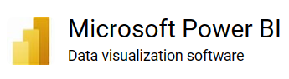



Tools Used

Slide 5
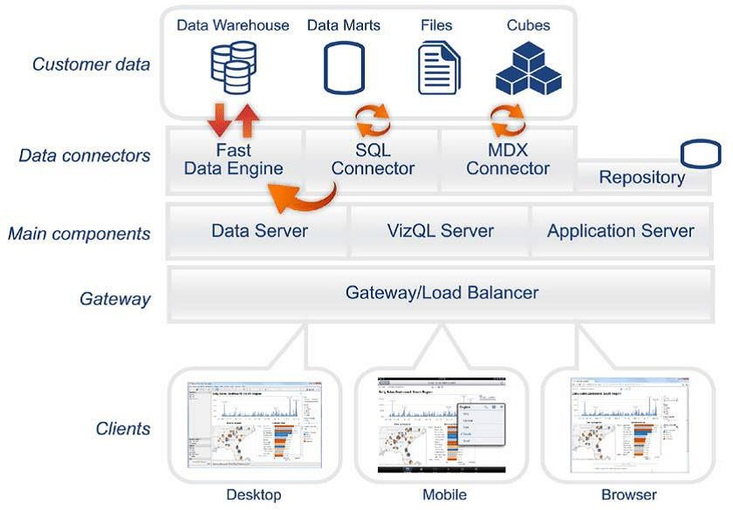
Architecture

Slide 6
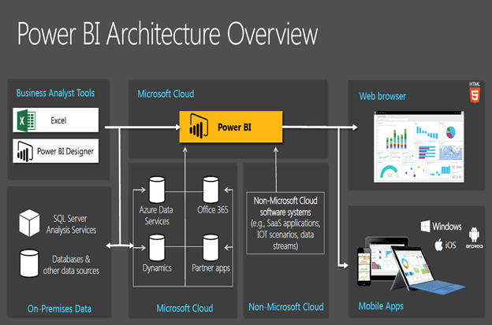

Slide 7
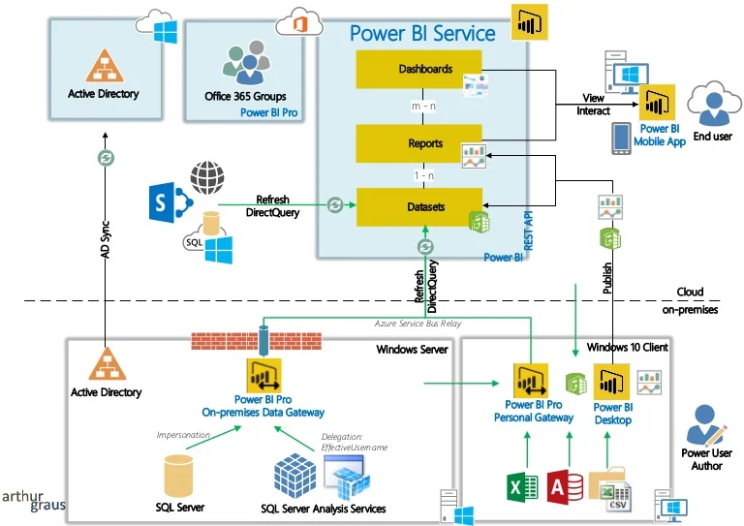

Slide 8
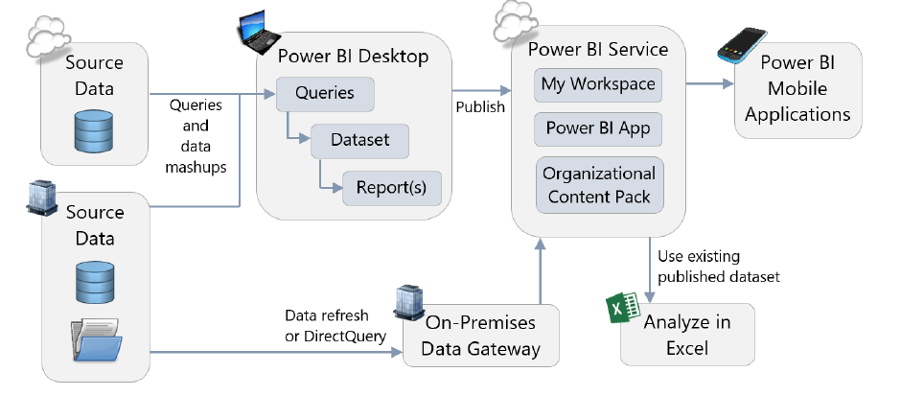

Slide 9

Project Report

Slide 10
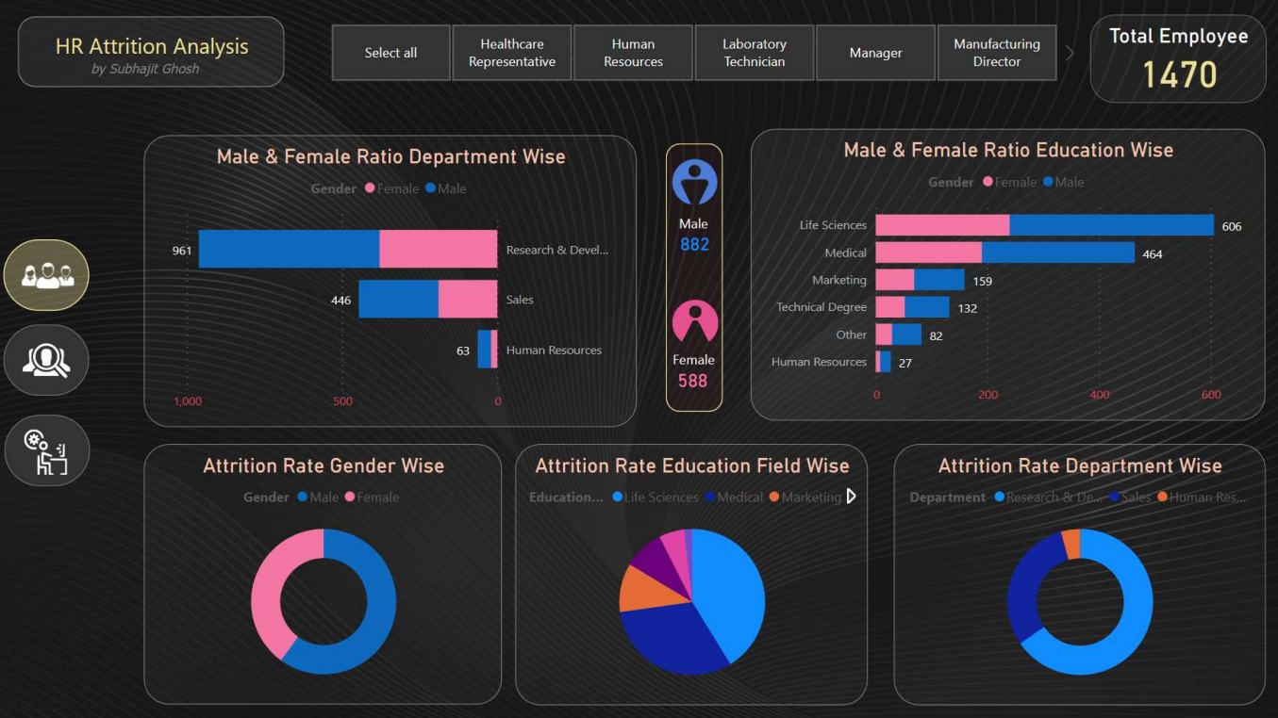

Slide 11
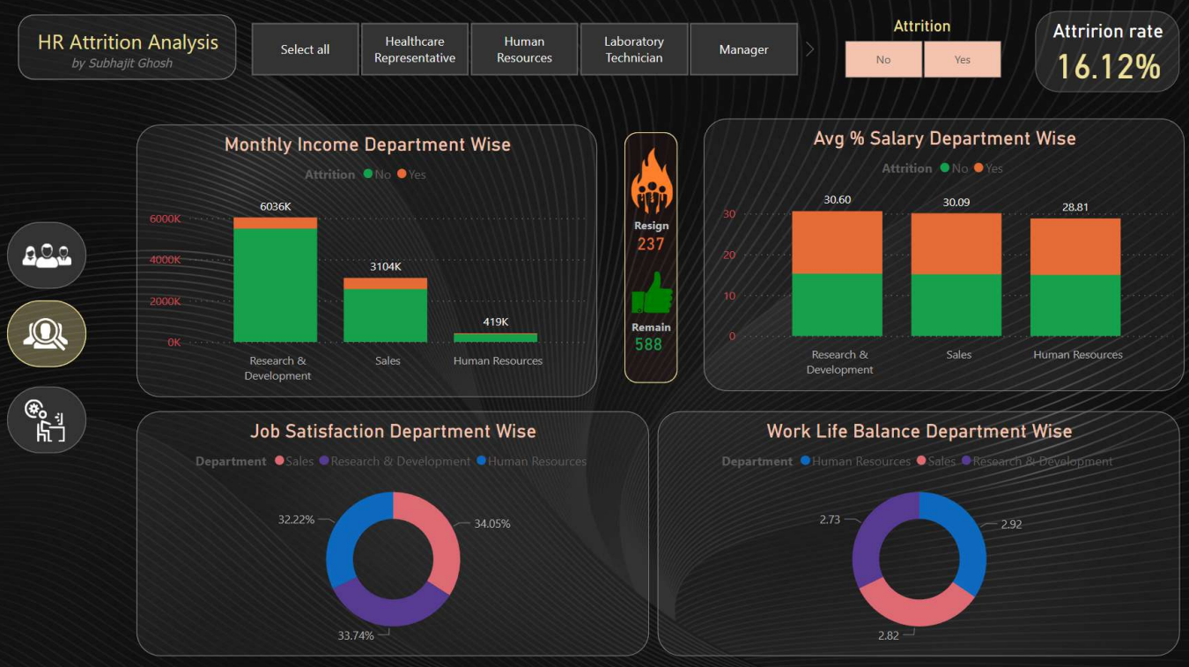

Slide 12
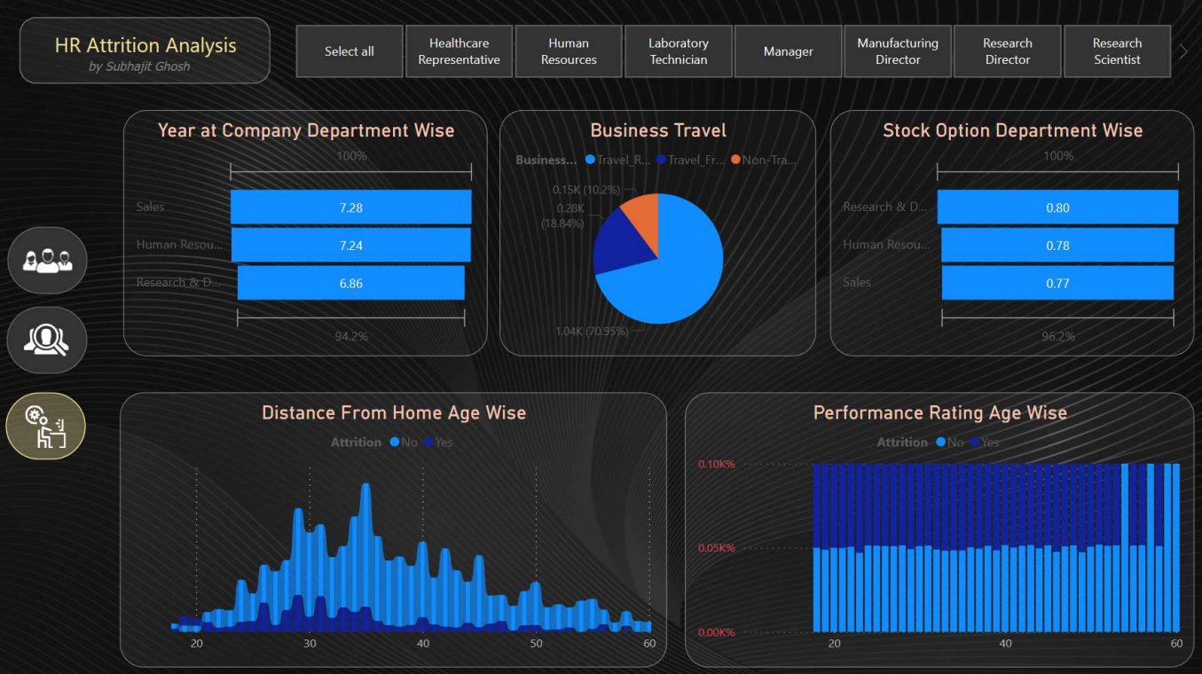

Slide 13
My Analysis
The total number of employees is 1470, and the total number of employees who left the company is 237 (150 male and 87 female), which gives us an attrition rate of 16.12%.
In terms of departments, the total number of Research & Development employees is 961, and the total number of employees who left the company is 133. The total number of sales employees is 446, and the total number of employees who left the company is 92. The total number of HR employees is 63, and the total number of employees who left the company is 12. It is worth noting that most of the employees leaving the company belong to the 30-40 age group.

Slide 14
The average monthly income of employees is 6502, with an average Percent Salary Hike of 15%, an average Job Satisfaction score of 3/5, and an average WorkLife Balance score of 3/5.
On the other hand, the employees who left the company had an average monthly income of 4787, an average Percent Salary Hike of 15% , an average Job Satisfaction score of 2.4/5, an average WorkLife Balance score of 2.6/5, an average Distance From Home of 9, an average Performance Rating of 3, and an average Year at Company of 7.
Lastly, the employees who left the company had an average Distance from home of 10.6, an average Performance Rating of 3, and an average Year At Company of 5.
These insights can help HR managers and decision-makers to take action and develop strategies to reduce attrition rates, improve employee satisfaction, and retain valuable employees. I hope this dashboard can be useful to anyone interested in understanding and improving HR practices

Slide 16
Problem Statement
HR is not just about hiring people it is an ocean of its own. HR department goes through a constant journey of finding, selecting, onboarding and monitoring the right talent. You are required to use analytics concept to provide a smooth monitoring of workforce for the HR department. Job classifications reflect both job families and pay grade related information. This is especially relevant when new jobs are created which need to fit in the existing job structure. Jobs have a number of distinct features which impact the job’s classification. These include education level, experience, organizational impact, level of supervision, financial budget, and more. Knowing these factors for different jobs enables a job analyst to classify jobs into groups – which are connected to pay scales and benefit packages. Sundmark points out that Linear Discriminant Analysis (LDA) can be used to find combinations of features which characterize a number of classes of objects or events. Using LDA, Sundmark’s job classification data set can be used to classify newly created jobs in the existing job structure, providing guidelines for newly created functions

Slide 17
Problem Statement
HR is not just about hiring people it is an ocean of its own. HR department goes through a constant journey of finding, selecting, onboarding and monitoring the right talent. You are required to use analytics concept to provide a smooth monitoring of workforce for the HR department. Job classifications reflect both job families and pay grade related information. This is especially relevant when new jobs are created which need to fit in the existing job structure. Jobs have a number of distinct features which impact the job’s classification. These include education level, experience, organizational impact, level of supervision, financial budget, and more. Knowing these factors for different jobs enables a job analyst to classify jobs into groups – which are connected to pay scales and benefit packages. Sundmark points out that Linear Discriminant Analysis (LDA) can be used to find combinations of features which characterize a number of classes of objects or events. Using LDA, Sundmark’s job classification data set can be used to classify newly created jobs in the existing job structure, providing guidelines for newly created functions

Slide 18
Event timeline
11:00am
As guests arrive, greet and usher to their seats outside
11:30am
Ribbon cutting ceremony will commence
12:00pm
Send guests to dining commons for food & music
2:30pm
Send guests to conference room for presentation
3:00pm
Presentation begins
3:30pm
Closing remarks from the founder
4:00pm
Group photos

Slide 19





Plan for food & beverage
Number of guests
Tables
Drinks
Starters
Entrees
Confirmed: 24
Tentative: 5
Declined: 3
4-top tables: 3
2-top tables: 6
Bar seating: 10
Water: sparkling & still
Tea: sweet & unsweet
Wine: white & red
Beer: domestic & foreign
Spring salad
Calamari
Oysters
Chilean sea bass
Roast duck
Charbroiled chicken breast

Slide 20

Sustainability planning
Subject to change

Slide 21

Planning agenda
Demonstrate our commitment to our goals
Present areas of current and projected growth
Reveal our "green goals" timeline
Discuss areas of focus

Slide 22
The beginning is the most important part of the work
“
”
- Plato

Slide 23
Commitment to sustainability

Slide 24
Areas of growth
 | Food | Energy | Water | Waste
Q1 | 4.5 | 2.3 | 1.7 | 5.0
Q2 | 3.2 | 5.1 | 4.4 | 3.0
Q3 | 2.1 | 1.7 | 2.5 | 2.8
Q4 | 4.5 | 2.2 | 1.7 | 7.0

Slide 25





Timeline
Sep 20XX
Nov 20XX
Jan 20XX
Mar 20XX
May 20XX
Synergize scalable e-commerce
Disseminate standardized metrics
Coordinate e-business applications
Foster holistically superior methodologies
Deploy strategic networks with compelling e-business needs

Slide 26

Areas of focus
B2B market scenarios
Cloud-based opportunities
Develop winning strategies to keep ahead of the competition
Capitalize on low-hanging fruit to identify a ballpark value
Visualize customer directed convergence
Iterative approaches to corporate strategy
Establish a management framework from the inside

Slide 27




Meet our team
Takuma Hayashi​
Mirjam Nilsson​
Flora Berggren​
Rajesh Santoshi​
President
Chief Executive Officer
Chief Operations Officer
VP Marketing

Slide 28




Meet our extended team
Takuma Hayashi​
Mirjam Nilsson​
Flora Berggren​
Rajesh Santoshi​
President
Chief Executive Officer
Chief Operations Officer
VP Marketing
Graham Barnes
Rowan Murphy
Elizabeth Moore
Robin Kline
VP Product
SEO Strategist
Product Designer
Content Developer

Slide 29

Group photo times
Group 1
Group 2
Group 3
Guests whose last name begins with A-H
Photo time slot is 6pm-6:30pm​
Guests whose last name begins with I-R
Photo time slot is 6:45pm-7:15pm
Guests whose last name begins with S-Z
Photo time slot is 7:30pm-8pm

Slide 30

Closing remarks
At Contoso, we believe in giving 110%. By using our next-generation data architecture, we help organizations virtually manage agile workflows. We thrive because of our market knowledge and great team behind our product. As our CEO says, "Efficiencies will come from proactively transforming how we do business."

Slide 31

Thank you
Mirjam Nilsson​
mirjam@contoso.com
www.contoso.com

